Slide 1

Exploratory analysis of Big Data and Cloud EDABDC
Data Models

Slide 2
Common data models
Data Model | Structure | Relationships | Use Cases | Tools
Hierarchical Data Model | Tree-like structure | Parent-child | Organizational charts, file systems | XML editor
Relational Data Model Entity-Relationship Model | Tables (relations) Entities and relationships | Foreign keys and primary keys One-to-one, one-to-many, many-to-many | Financial systems, inventory management Database design | SQLite Browser, Azure SQL, MS SQL Server, MySQL, PostgreSQL, BigER vs code plugin
Document Data Model (NoSQL database) | Documents (JSON, XML) | Embedded relationships | Content management systems, web applications | MongoDB, CouchDB
Key-Value Data Model | Key-value pairs | Simple lookup | Session storage, user profiles | Redis, AWS DynamoDB

Slide 3
Common data models (Cont.)
Data Model | Structure | Relationships | Use Cases | Tools
Graph Data Model | Nodes and edges | Explicitly stored edges | Social networks, recommendation engines | Neo4j, OrientDB
Multi-Model Databases | Supports multiple data models | Various types | Flexible data handling, diverse use cases | ArangoDB, Couchbase

Slide 4
Importance of Data Models
Data Organization: Helps in organizing and structuring data efficiently.
Data Integrity: Ensures the accuracy and consistency of data through constraints and rules.
Data Access: Facilitates easy and efficient access to data for queries and transactions.
Scalability: Allows databases to scale and handle large volumes of data.
Maintenance: Simplifies data management and maintenance over time.

Slide 5
Common data models
Hierarchical Data Model
Relational Data Model
Document Data Model
Key-Value Data Model
Graph Data Model
Multi-Model Databases

Slide 6
Key-Value Data Model
The key-value data model is one of the simplest forms of data storage paradigms and is widely used for its performance, scalability, and flexibility.

Slide 7
Key Concepts
Keys
Unique identifiers used to reference values.
Typically, keys are simple, such as strings or numbers.
Values
The data or information associated with a key.
Can be of various types, such as strings, numbers, JSON objects, binary data, or any arbitrary data structure.

Slide 8
Key-Value Pair
The fundamental unit of the key-value model, consisting of a unique key and its associated value.
Example: "user123": {"name": "John Doe", "email": "john.doe@example.com"}.

Slide 9
Operations
Get:
Retrieves the value associated with a given key.
Example: GET "users:user123" might return {"name": "John Doe", "email": "john.doe@example.com"}.
Set:
Inserts or updates the value associated with a given key.
Example: set "users:user123" '{"name": "John Doe", "email": "john.doe@example.com"}'
Delete:
Removes the key-value pair associated with a given key.
Example: DELETE "user123".

Slide 10
Advantages
Performance:
Optimized for fast read and write operations.
Efficient retrieval due to direct access via keys.
Simplicity:
Easy to understand and use.
Minimal overhead compared to more complex data models.
Scalability:
Suitable for distributed systems.
Can handle large volumes of data and high-velocity read/write operations.
Flexibility:
Values can be of any type, allowing for diverse data storage needs.
Schema-less nature permits storing unstructured or semi-structured data.

Slide 11
Disadvantages
Limited Query Capabilities:
Basic operations are limited to key-based access.
Lacks advanced querying features such as joins, filtering, or aggregations found in relational databases.
Data Relationships:
Poor support for complex relationships and structured data compared to other models like relational or graph databases.
Data Integrity:
Ensuring data integrity and enforcing constraints must be handled at the application level.

Slide 12
key-value data model use cases
Caching:
Frequently accessed data can be cached to improve performance.
Example: Using Redis as a caching layer to store session data.
Session Management:
Storing user session information in web applications.
Example: Session data for a logged-in user.
Configuration Management:
Storing application configuration settings.
Example: Feature flags and application settings in a key-value store.
Real-Time Analytics:
Handling high-velocity data in real-time applications.
Example: Storing and retrieving real-time metrics and counters.

Slide 13


Popular Key-Value Databases
Redis:
An in-memory key-value store known for its high performance and rich feature set, including support for various data structures like lists, sets, and hashes.
Amazon DynamoDB:
A fully managed key-value and document database service designed for high availability and scalability.

Slide 14
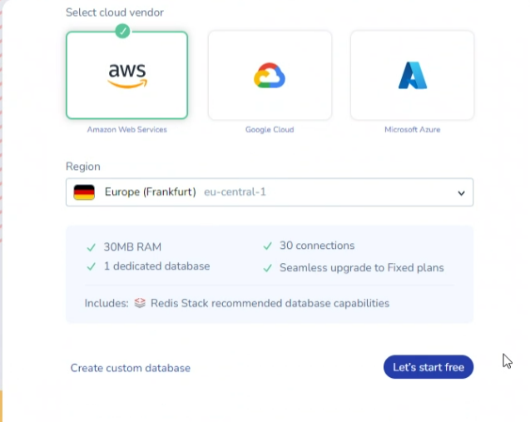
redis.io/try-free

Slide 15
in-memory database
MemoryDB is a Redis-compatible, durable, in-memory database service that is designed to deliver ultrafast performance.
MemoryDB can help you achieve microsecond read latency, single-digit millisecond write latency and high throughput
Redis Advantages:
Exceptionally fast − Redis is very fast and can perform about 110000 SETs per second, about 81000 GETs per second.

Slide 16
organize your data in redis
you can use keys with prefixes to organize your data. The prefix can be anything that makes sense for your application, such as "user:key", "product:key", "order:key", etc.

Slide 17
Redis key types
Strings
Description: The most basic and widely used Redis data type. Strings can store any kind of data, such as text, numbers, or binary data.
Operations:
SET key value
GET key
INCR key (increments the value stored at the key)
APPEND key value (appends a value to an existing string)
Use Cases: Caching, counters, simple key-value storage.

Slide 18
Redis key types
Hashes
Description: A collection of key-value pairs, where the keys and values are both strings. Useful for representing objects.
Operations:
HSET key field value
HGET key field
HGETALL key (retrieves all fields and values in the hash)
HDEL key field (deletes a field from the hash)
Use Cases: Storing user profiles, session information, and objects with multiple attributes.

Slide 19
Redis key types
Lists
Description: Ordered collections of strings. Lists can be used as queues, stacks, or for message passing.
Operations:
LPUSH key value (prepends a value to the list)
RPUSH key value (appends a value to the list)
LPOP key (removes and returns the first element of the list)
RPOP key (removes and returns the last element of the list)
LRANGE key start stop (retrieves a range of elements from the list)
Use Cases: Task queues, message queues, logs, latest items lists.

Slide 20
Redis key types
Sets
Description: Unordered collections of unique strings. Sets are useful for storing unique values and performing set operations.
Operations:
SADD key value (adds a value to the set)
SREM key value (removes a value from the set)
SMEMBERS key (retrieves all members of the set)
SISMEMBER key value (checks if a value is a member of the set)
Use Cases: Tags, unique identifiers, membership checks

Slide 21
Redis key types
Sorted Sets (Zsets)
Description: Similar to sets but with an associated score for each member, allowing the elements to be sorted.
Operations:
ZADD key score member (adds a member with a score to the sorted set)
ZRANGE key start stop (retrieves members by their rank)
ZRANGEBYSCORE key min max (retrieves members by their score range)
ZREM key member (removes a member from the sorted set)
Use Cases: Leaderboards, ranking systems, priority queues.

Slide 22
Redis key types
Streams
Description: An append-only log data structure designed for real-time data ingestion and consumption.
Operations:
XADD key ID field value (adds an entry to the stream)
XRANGE key start end (retrieves entries in a range of IDs)
XREAD COUNT count STREAMS key ID (reads entries from streams)
Use Cases: Real-time messaging, event sourcing, logging

Slide 23
Redis key types
JSON (with RedisJSON Module)
Description: Stores and manages JSON documents natively within Redis.
Operations:
JSON.SET key path value (sets a JSON value at the specified path)
JSON.GET key path (retrieves a JSON value from the specified path)
JSON.DEL key path (deletes a JSON value at the specified path)
Use Cases: Document storage, nested data, application configuration.

Slide 24
Search
exact match
full-text search
range queries
geospacial queries
vector search

Slide 25

Questions

Slide 26
Common data models
Hierarchical Data Model
Relational Data Model
Document Data Model
Key-Value Data Model
Graph Data Model
Multi-Model Databases

Slide 27
Graph data model
Designed to represent and manage highly interconnected data, making it ideal for applications involving complex relationships.
Structures data as nodes, edges, and properties, enabling the modeling of real-world entities and their interconnections intuitively and efficiently

Slide 28
Key Concepts
Nodes (Vertices):
Represent entities or objects in the graph.
Each node can have properties, which are key-value pairs that store information about the node.
Example: In a social network, nodes can represent users.
Edges (Relationships):
Represent the connections or relationships between nodes.
Each edge can also have properties, storing information about the relationship.
Edges are usually directed (have a start and end node) but can also be undirected.
Example: In a social network, edges can represent friendships or following relationships.
Properties:
Attributes or metadata associated with nodes and edges.
Example: A user node might have properties like name, age, and email, while a friendship edge might have properties like start date and relationship type.

Slide 29
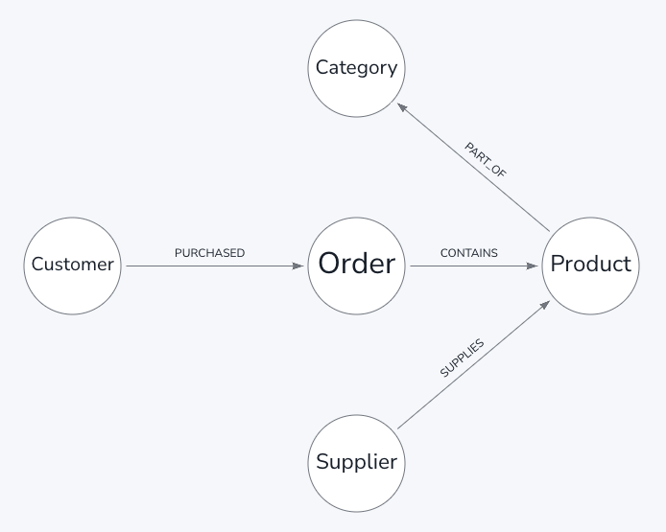
Graph
A graph database stores nodes (Supplier, Product, etc) and their relationships (e.g. Supplier SUPPLIES Product).

Slide 30
Graph Data Structures
Property Graph Model:
The most common graph data model.
Nodes and edges can have any number of properties.
Example: Neo4j uses the property graph model.
RDF (Resource Description Framework) Model:
Uses triples to represent data, consisting of subject, predicate, and object.
Often used for semantic web and linked data applications.
Example: Apache Jena and RDF4J.

Slide 31
Graph data model Advantages
Flexibility:
Schema-less nature allows for easy modifications and extensions of the graph structure.
Suitable for semi-structured and evolving data.
Expressiveness:
Natural way to represent relationships and connections.
Enables complex queries involving traversals and pattern matching.
Performance:
Efficient for querying and traversing deep and complex relationships.
Optimized for graph operations like shortest path, neighborhood search, and subgraph matching.

Slide 32
Disadvantages
Complexity:
Can become complex to manage and visualize as the graph grows in size and density.
Requires specialized knowledge for effective use and optimization.
Scalability:
While some graph databases scale horizontally, handling very large graphs can be challenging compared to simpler data models.

Slide 33
Graph data model use cases
Social Networks:
Modeling users and their relationships (friendships, follows, likes).
Example: Finding friends of friends, recommending new connections.
Recommendation Engines:
Using relationships between users, items, and their interactions to provide recommendations.
Example: Product recommendations based on user behavior and preferences.
Fraud Detection:
Analyzing transaction patterns and relationships to detect anomalies and fraudulent activities.
Example: Detecting suspicious transaction patterns in financial networks.

Slide 34
Graph data model use cases
Knowledge Graphs:
Integrating and linking various data sources to create a comprehensive knowledge base.
Example: Google's Knowledge Graph, which connects information about people, places, and things.
Network and IT Operations:
Managing and analyzing network topologies, IT infrastructure, and dependencies.
Example: Visualizing and diagnosing network issues and dependencies.

Slide 35
Tools
Neo4j:
A widely used property graph database with a rich set of features and tools.
Known for its Cypher query language.
ArangoDB:
A multi-model database supporting graph, document, and key-value data models.

Slide 36
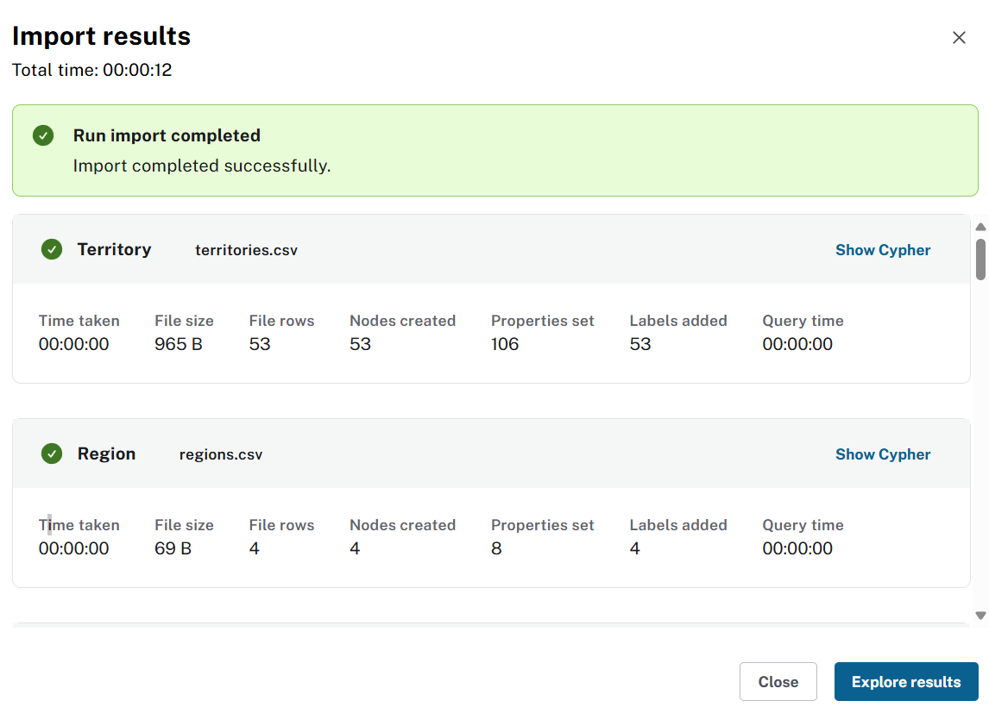
Neo4J import Northwind data

Slide 37
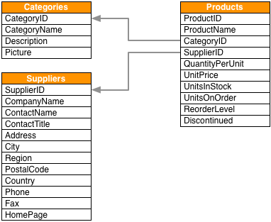
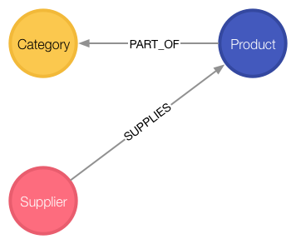
from relation data model to graph data model Northwind data

Slide 38
Basic Querying
Load query for product nodes
MATCH (n:Product)
RETURN n
LIMIT 25

Slide 39
All products ordered by a customer and who supplies those
MATCH path=(c:Customer)-[:PURCHASED]->()-[:ORDERS]->(:Product)<-[:SUPPLIES]-(:Supplier)
WHERE c.companyName = 'Blauer See Delikatessen'
RETURN path;

Slide 40
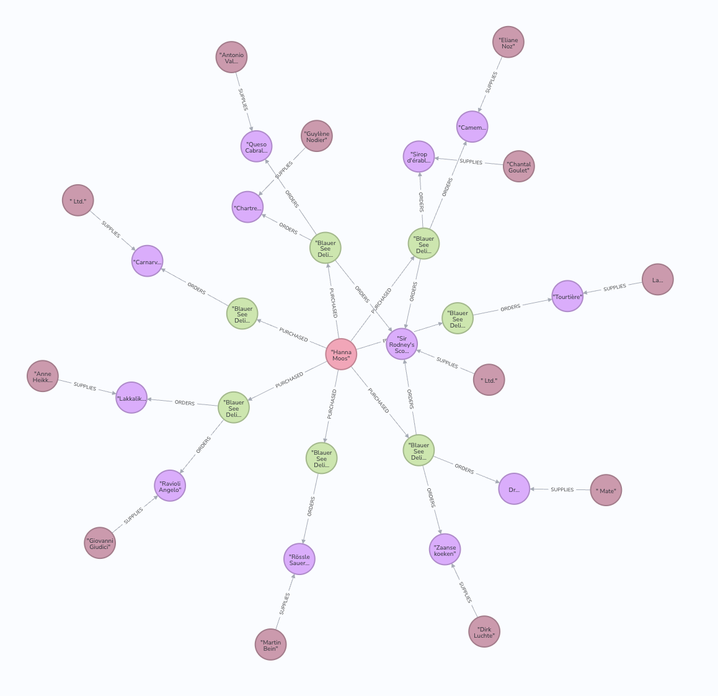

Slide 41
Find total quantity per customer in the "Produce" category
MATCH (cust:Customer)-[:PURCHASED]->(:Order)-[o:ORDERS]->(p:Product),
(p)-[:PART_OF]->(c:Category {categoryName:'Produce'})
RETURN cust.contactName as CustomerName,
sum(o.quantity) AS TotalProductsPurchased

Slide 42
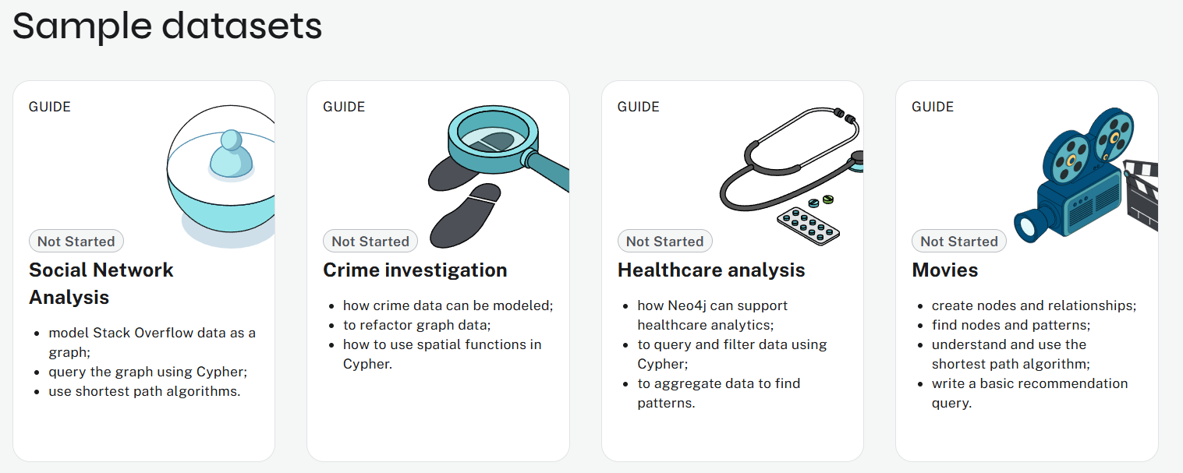
sample datasets

Slide 43
Different data models

Slide 44
<Data>
<Categories>
<Category id="1" name="Beverages" desc="Soft drinks, coffees, teas, beers, and ales" pic="image_url_or_base64"/>
<Category id="2" name="Condiments" desc="Sweet and savory sauces, relishes, spreads, and seasonings" pic="image_url_or_base64"/>
</Categories>
<Suppliers>
<Supplier id="1" company="Exotic Liquids" contact="Charlotte Cooper" title="Purchasing Manager" addr="49 Gilbert St." city="London" postal="EC1 4SD" country="UK" phone="(171) 555-2222"/>
<Supplier id="2" company="New Orleans Cajun Delights" contact="Shelley Burke" title="Order Administrator" addr="P.O. Box 78934" city="New Orleans" region="LA" postal="70117" country="USA" phone="(100) 555-4822"/>
</Suppliers>
<Products>
<Product id="1" name="Chai" catId="1" supId="1" qty="10 boxes x 20 bags" price="18.00" stock="39" order="0" reorder="10" disc="false"/>
<Product id="2" name="Chang" catId="1" supId="1" qty="24 - 12 oz bottles" price="19.00" stock="17" order="40" reorder="25" disc="false"/>
</Products>
</Data>

Slide 45
{
"Categories": [
{ "CategoryID": 1, "CategoryName": "Beverages", "Description": "Soft drinks, coffees, teas, beers, and ales", "Picture": "image_url_or_base64" },
{ "CategoryID": 2, "CategoryName": "Condiments", "Description": "Sweet and savory sauces, relishes, spreads, and seasonings", "Picture": "image_url_or_base64" }
],
"Suppliers": [
{ "SupplierID": 1, "CompanyName": "Exotic Liquids", "ContactName": "Charlotte Cooper", "ContactTitle": "Purchasing Manager", "Address": "49 Gilbert St.", "City": "London", "Region": null, "PostalCode": "EC1 4SD", "Country": "UK", "Phone": "(171) 555-2222", "Fax": null, "HomePage": null },
{ "SupplierID": 2, "CompanyName": "New Orleans Cajun Delights", "ContactName": "Shelley Burke", "ContactTitle": "Order Administrator", "Address": "P.O. Box 78934", "City": "New Orleans", "Region": "LA", "PostalCode": "70117", "Country": "USA", "Phone": "(100) 555-4822", "Fax": null, "HomePage": null }
],
"Products": [
{ "ProductID": 1, "ProductName": "Chai", "CategoryID": 1, "SupplierID": 1, "QuantityPerUnit": "10 boxes x 20 bags", "UnitPrice": 18.00, "UnitsInStock": 39, "UnitsOnOrder": 0, "ReorderLevel": 10, "Discontinued": false },
{ "ProductID": 2, "ProductName": "Chang", "CategoryID": 1, "SupplierID": 1, "QuantityPerUnit": "24 - 12 oz bottles", "UnitPrice": 19.00, "UnitsInStock": 17, "UnitsOnOrder": 40, "ReorderLevel": 25, "Discontinued": false }
]
}

Slide 46
from relation data model to graph data model Northwind data

Slide 47
Questions

